Slide 1
Lower respiratory tract infection

Slide 2
Pneumonia
an inflammation of the parenchyma of the lungs

Slide 3
Epidemiology
is the leading cause of death globally among children < 5 yr
Accounting for an estimated 920,000 deaths each year
mortality is closely linked to poverty
> 99% of pneumonia deaths are in low- and middle-income countries
  highest mortality rate occurring in poorly developed countries in Africa and South Asia

Slide 4
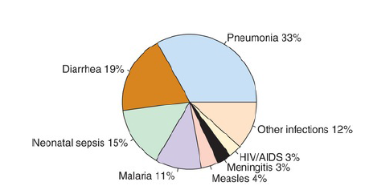
Notes:
Pneumonia is the leading infectious killer of children worldwide,
as shown by this illustration of global distribution of cause-specific
infectious mortality among children younger than age 5 yr in 2015.
Pneumonia causes one-third of all under-5 deaths from infection. (From
World Health Organization and Maternal and Child Epidemiology
Estimation Group estimates, 2015.)

Slide 5
In the US pneumonia mortality in children declined by 97%,probably as a result from
  introduction of antibiotics
  Vaccines
  expansion of medical insurance coverage for children
Vaccines which prevents from pneumonia
  Haemophilus influenzae type b vaccine
  Measles vaccine
  Pertusis vaccine
  Pneumococcal conjugate vaccines
Notes:
In the United States, mortality from pneumonia in children declined by 97%
between 1939 and 1996. This decline likely resulted from the development of
antibiotics and vaccines and the expansion of medical insurance coverage for
children. Effective vaccines against measles (see Chapter 273 ) and pertussis
(see Chapter 224 ) contributed to the decline in pneumonia-related mortality
during the 20th century. Haemophilus influenzae type b (see Chapter 221 ) was
also an important cause of bacterial pneumonia in young children but became
uncommon following licensure of a conjugate vaccine in 1987. The introduction
of pneumococcal conjugate vaccines (PCVs) (see Chapter 209 ) has been an
important contributor to the further reductions in pneumonia-related mortality
achieved over the past 15 yr.

Slide 6
Etiology
The cause is difficult to determine because
  Direct culture of lung tissue is invasive and rarely performed
  Cultures performed on specimens obtained from the upper respiratory tract or “sputum” generally do not accurately reflect the cause

Slide 7
1. Infectious
  Most common cause
  Viral pathogens are a prominent cause in infants and children <5 yr of age
  Viruses can be detected in 40-80% of children with pneumonia using molecular diagnostic methods

Slide 8
RSV and rhinoviruses - most commonly identified pathogens , especially in <2 yr of age
Infection with more than 1 respiratory virus occurs in up to 20% of cases
Notes:
However, the role of rhinoviruses in severe lower respiratory tract infection remains poorly defined as these viruses are frequently detected in infections with 2 or more pathogens .
Lower respiratory tract viral infections are much more common in
the fall and winter in both the northern and southern hemispheres in
relation to the seasonal epidemics of respiratory viral infection that
occur each year. The typical pattern of these epidemics usually begins
in the fall, when parainfluenza infections appear and most often mani-fest as croup. Later in winter, RSV, human metapneumovirus, and
influenza viruses cause widespread infection, including upper respira-tory tract infections, bronchiolitis, and pneumonia.
and among asymptomatic children.

Slide 9
RSV is particularly severe among infants and young children
Influenza virus causes disease and excess hospitalization for acute respiratory illness in all age groups
Knowledge of the prevailing viral epidemic may lead to a presuptive initial diagnosis.
Notes:
Viral pathogens are a prominent cause of LRTI in infants and children older than 1 mo but younger than 5 yr of age
Viruses can be detected in 40-80% of children with pneumonia using molecular diagnostic methods. Of the respiratory viruses,
respiratory syncytial virus (RSV) (see Chapter 260) and rhinoviruses
are the most commonly identified pathogens, especially in children
younger than 2 yr of age. However, the role of rhinoviruses in severe
lower respiratory tract infection remains poorly defined as these
viruses are frequently detected in infections with 2 or more pathogens
and among asymptomatic children.

Slide 10
Immunization status - fully immunized against H. influenzae type b and S. pneumoniae are less likely to be infected with these pathogens
immunosuppressed or who have an underlying illness may be at risk for specific pathogens
  Pseudomonas spp. in patients with cystic fibrosis

Slide 11
In Developed Country
  S. pneumoniae is the most common bacterial pathogen
  Followed by C.pneumoniae and M. pneumoniae
In Developing Countries
  S. pneumonia
  H.influenza
  S. aureus
Notes:
S. aureus pneumonia often complicates an illness caused by influenza viruses
S. pneumoniae, H. influenzae,and S. aureusare the major causes of hospitalization and death from bacterial pneumonia among children in developing countrie

Slide 12
In Immunocompromised children
  M. tuberculosis
  atypical mycobacterium
  Salmonella
  E.coli
  Pneumocystis jirovecii
  cytomegalovirus

Slide 13
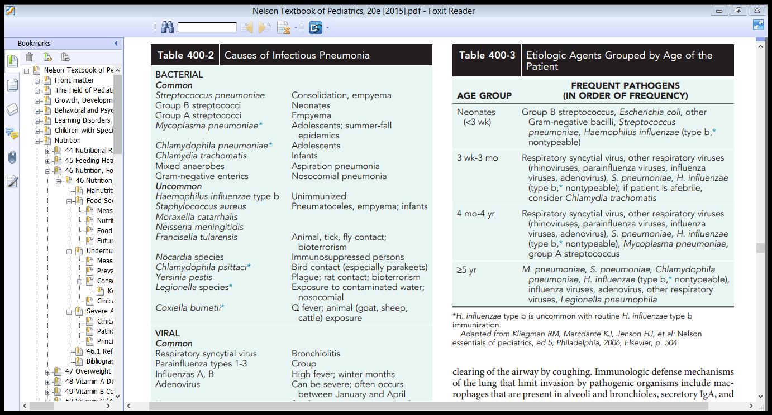

Slide 14
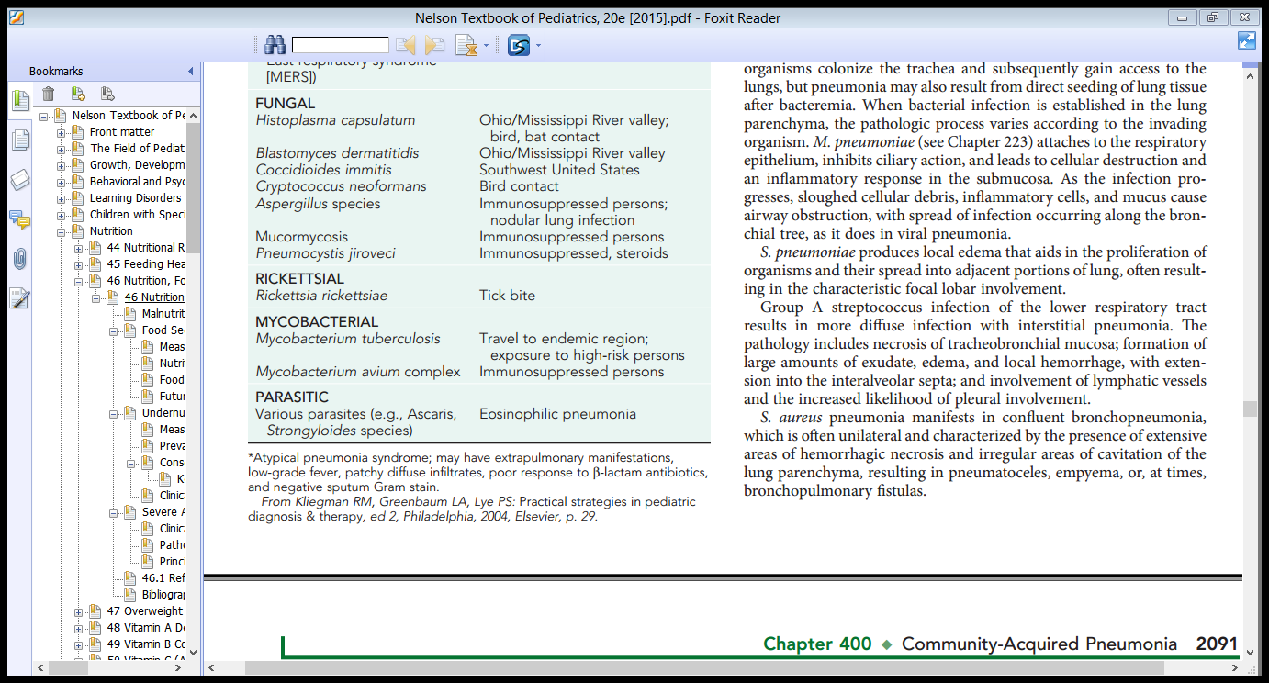
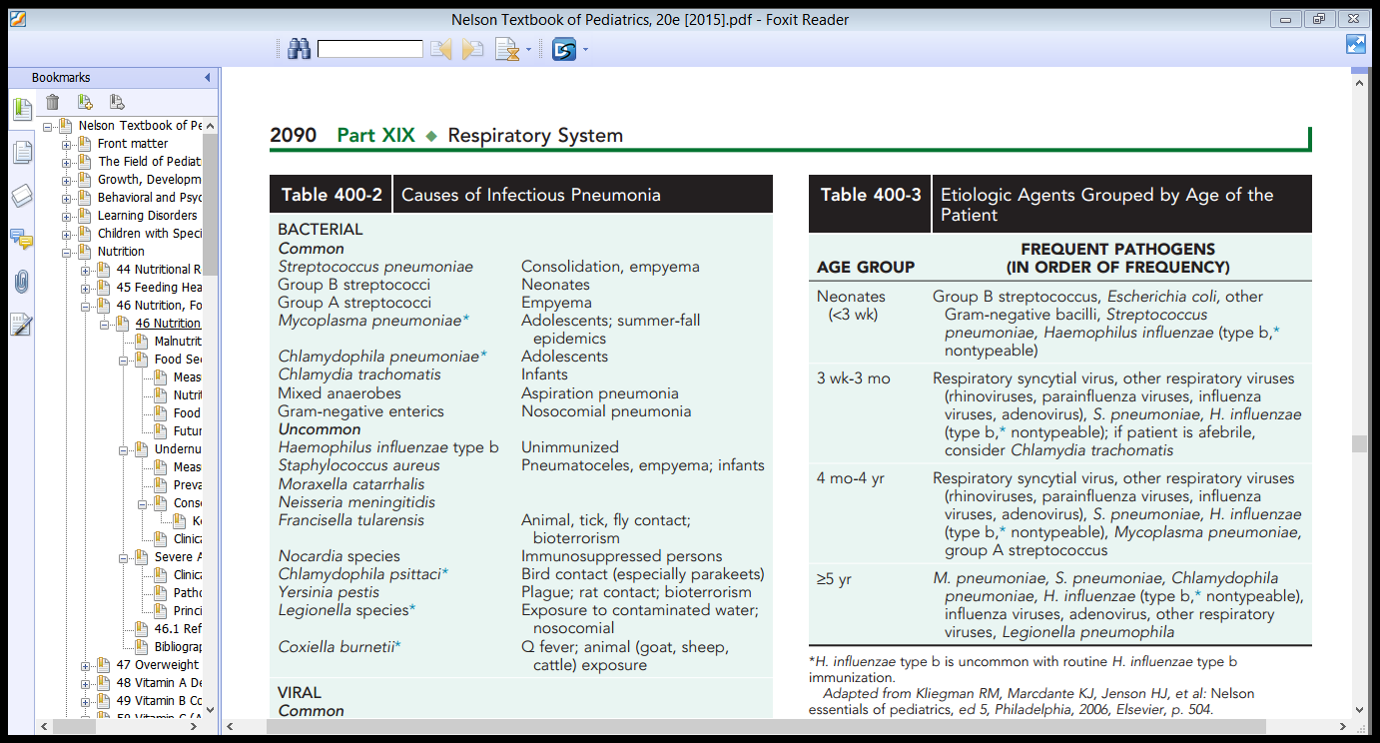
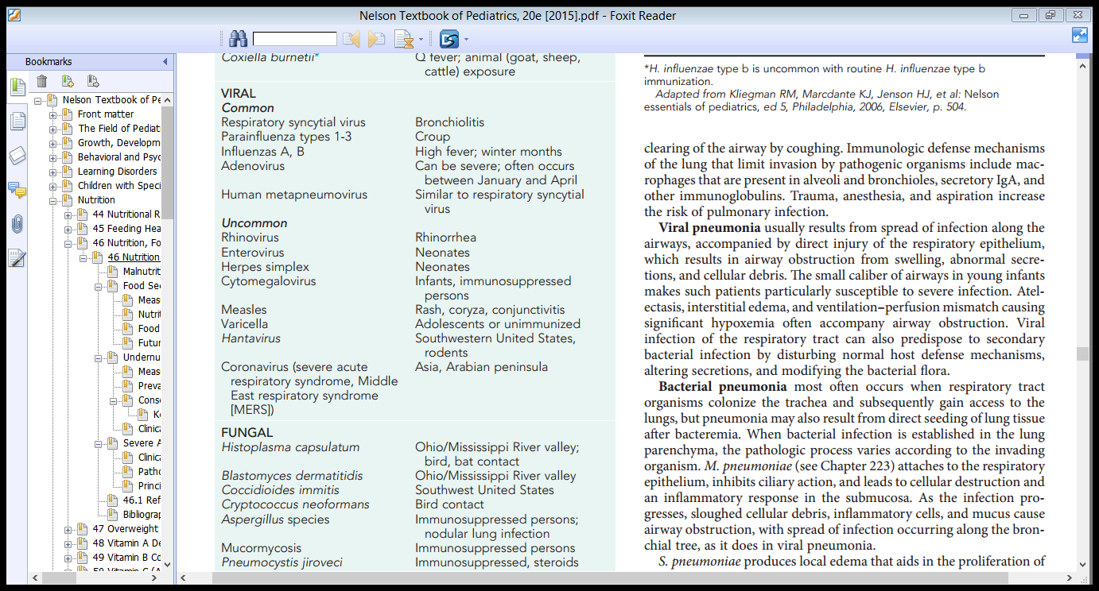

Slide 15
2. Noninfectious
Aspiration of
  Food or gastric acid
  Foreign bodies
  Hydrocarbons
  Lipoid substances
Hypersensitivity reactions
  Drug induced
  Radiation-induced pneumonitis

Slide 16
Pathogenesis
The lower respiratory tract possesses a number of defense mechanisms against infection
mucociliary clearance
macrophages
secretory immunoglobulin A
clearing of the airways by coughing
Notes:
B. Immunologic mechanism
When the mechanical barriers are overcome or when the microorganisms are small enough to be inhaled to the alveolar level, resident alveolar macrophages are extremely efficient at clearing and killing pathogens.
Macrophages are assisted by local proteins (e.g., surfactant proteins A and D) that have intrinsic opsonizing properties or antibacterial or antiviral activity.
Once engulfed, the pathogens—even if they are not killed by macrophages—are eliminated via either the mucociliary elevator or the lymphatics and no longer represent an infectious challenge.
Only when the capacity of the alveolar macrophages to ingest or kill the microorganisms is exceeded does clinical pneumonia become manifest.

Slide 17
it was believed that the LRT was—in the absence of infection—kept sterile
Currently, that the LRT contains diverse microbial communities
disruption of a complex lower respiratory ecosystem that is the site of dynamic interactions between potential pneumonia pathogens, resident microbial communities, and host immune defenses
Notes:
challenged the traditional model of pneumonia pathogenesis that maintained that pneumonia was the result of invasion of the sterile lower respiratory tract by a single pathogen. More recent conceptual models postulate that pneumonia results from
Previously, it was believed that the lower respiratory tract was—in the absence of infection—kept sterile by these mechanisms, supported primarily by culture-based studies.
However, recent use of culture-independent techniques, including highthroughput
sequencing methods, suggests that the lower respiratory tract
contains diverse microbial communities. These data have challenged the
traditional model of pneumonia pathogenesis that maintained that pneumonia
was the result of invasion of the sterile lower respiratory tract by a single
pathogen

Slide 18
Microorganisms gain access to the LRT in several ways
  aspiration from the oropharynx - most common
  Many pathogens are inhaled as contaminated droplets
  Rarely occurs via
    Hematogenous spread
    By contiguous extension from an infected pleural or mediastinal space

Slide 19
Viral pneumonia
  Results from Spread of infection along the airways
  results direct injury of the respiratory epithelium, resulting in airway obstruction from swelling, abnormal secretions, and cellular debris.
  Predispose to secondary bacterial infection by disturbing normal host defense mechanisms, modifying the bacterial flora
Notes:
Viral pneumonia usually results from Spread of infection along the airways, accompanied by direct injury of the respiratory epithelium, resulting in airway obstruction from swelling, abnormal secretions, and cellular debris.

Slide 20
The small caliber of airways in young infants makes them particularly susceptible to severe infection
Atelectasis, interstitial edema, and ventilation-perfusion mismatch causing significant hypoxemia often accompany airway obstruction

Slide 21
M. pneumoniae
Attaches to the respiratory epithelium
Inhibits ciliary action Cellular destruction and an inflammatory response in the submucosa.
Air way obstruction causes by sloughed cellular debris, inflammatory cells, and mucus
Spread of infection occurring along the bronchial tree, as it does in viral pneumonia.
Notes:
Bacterial pneumoniamost often occurs when respiratory tract
organisms colonize the trachea and subsequently gain access to the
lungs, but pneumonia may also result from direct seeding of lung tissue
after bacteremia. When bacterial infection is established in the lung
parenchyma, the pathologic process varies according to the invading
organism. Attaches to the respiratory epithelium
Inhibits ciliary action, and leads to cellular destruction and an inflammatory response in the submucosa.
As the infection progresses, sloughed cellular debris, inflammatory cells, and mucus cause airway obstruction, with spread of infection occurring along the bronchial tree, as it does in viral pneumonia.

Slide 22
S. pneumoniae
Produces local edema that aids in the proliferation of organisms and their spread into adjacent portions of lung
Often resulting in the characteristic focal lobar involvement

Slide 23
GAS
Results in more diffuse infection with interstitial pneumonia
The pathology includes
  Necrosis of tracheobronchial mucosa
  Formation of large amounts of exudate, edema, and local hemorrhage with extension into the interalveolar septa
  Involvement of lymphatic vessels
Increased likelihood of pleural involvement

Slide 24
S. aureus pneumonia
Manifests in confluent bronchopneumonia
Is often unilateral
Characterized by
  Hemorrhagic necrosis
  Irregular areas of cavitation of the lung parenchyma resulting in pneumatoceles
  Empyema
  bronchopulmonary fistulas -at times

Slide 25
Recurrent pneumonia
2 or more episodes in a single year or 3 or more episodes ever, with radiographic clearing between occurrence
An underlying disorder should be considered if a child experiences recurrent
Notes:
Table 428.5
Differential Diagnosis of Recurrent Pneumonia

Slide 26
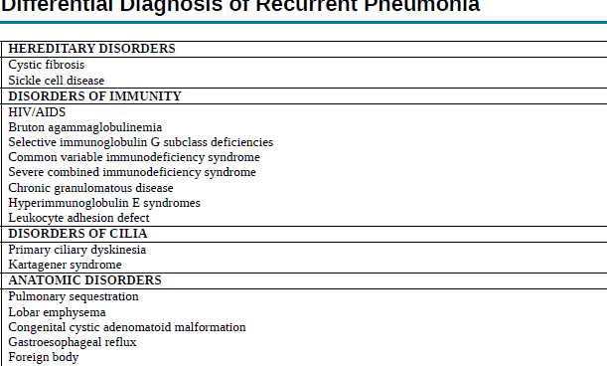

Differential Diagnosis of Recurrent Pneumonia

Slide 27
CLINICAL MANIFESTATIONS
Preceded by several days of symptoms of URTI typically rhinitis and cough
In viral pneumonia, fever is usually present but temperatures are generally lower than in bacterial pneumonia
Bacterial pneumonia In older children and adolescents
Brief URTI is followed by the abrupt onset of shaking chills and high fever
Accompanied by drowsiness with intermittent periods of restlessness; rapid respirations; a dry, hacking, unproductive cough; anxiety; and, occasionally, delirium
Notes:
Bacterial pneumonia in adults and older children typically begins suddenly with a shaking chill followed by a high fever, cough, and chest pain.
In older children and adolescents, a brief upper respiratory tract illness is followed by the abrupt onset of shaking chills and high fever accompanied by drowsiness with intermittent periods of restlessness; rapid respirations; a dry, hacking, unproductive cough; anxiety; and, occasionally, delirium.
Circumoral cyanosis may be observed.
Many children are noted to be splinting on the affected side to minimize pleuritic pain and improve ventilation; they may lie on their side with their knees drawn up to their chest.

Slide 28
Circumoral cyanosis may be observed
Many children are noted to be splinting on the affected side to minimize pleuritic pain and improve ventilation
They may lie on their side with their knees drawn up to their chest

Slide 29
Physical examination
V/S
  Tachypnea is the most consistent clinical manifestation of pneumonia
G/A
  Increased work of breathing accompanied by intercostal, subcostal, and suprasternal retractions, nasal flaring, and use of accessory muscles is common
Severe infection may be accompanied by cyanosis and respiratory fatigue, especially in infants

Slide 30
Chest
  Findings depends on the stage of pneumonia
  Early in the course of illness, diminished breath sounds, scattered crackles, and rhonchi are commonly heard over the affected lung field.
  With the development of increasing consolidation or complications such as effusion, empyema, or pyopneumothorax, dullness on percussion is noted and breath sounds may be diminished.
  A lag in respiratory excursion often occurs on the affected side.
Notes:
Auscultation of the chest may reveal crackles and wheezing, but it is often difficult to localize the source of these adventitious sounds in very young children with hyperresonant chests.

Slide 31
Abdomen
  Abdominal distention because of gastric dilation from swallowed air or ileus.
  Abdominal pain is common in lower lobe pneumonia.
  The liver may seem enlarged because of downward displacement of the diaphragm secondary to hyperinflation of the lungs or superimposed congestive heart failure.
  Nuchal rigidity, in the absence of meningitis, may also be prominent, especially with involvement of the right upper lobe

Slide 32
Bacterial pneumonia In infants
There may be a prodrome of upper respiratory tract infection and diminished appetite, leading to the abrupt onset of fever, restlessness, apprehension, and respiratory distress.
These infants appear ill with respiratory and often cyanosis.
Results of physical examination may be misleading with meager findings disproportionate to the degree of tachypnea.
Notes:
These infants appear ill with respiratory distress manifested by grunting; nasal flaring; retractions of the supraclavicular, intercostal, and subcostal areas; tachypnea; tachycardia; air hunger; and often cyanosis.

Slide 33
Some infants may have associated GI disturbances characterized by vomiting, anorexia, diarrhea, and abdominal distention secondary to a paralytic ileus.
Rapid progression of symptoms is characteristic in the most severe cases of bacterial pneumonia.

Slide 34
Diagnosis
CBC
CXR
  Confirms the diagnosis
  Indicate a complication
  Repeat chest x-rays are not required for proof of cure for patients with uncomplicated pneumonia

Slide 35
An infiltrate on chest radiograph (PA and lateral views) supports the diagnosis of pneumonia
Viral pneumonia - hyperinflation with bilateral interstitial infiltrates and peribronchial cuffing
Confluent lobar consolidation - typically seen with pneumococcal pneumonia
The radiographic appearance alone is not diagnostic
  other clinical features must be considered

Slide 36
current guidelines do not recommend that a CXR for suspected pneumonia who are well enough to be managed as outpatients
  only rarely changes management
Chest ultrasonography - highly sensitive and specific
  determining lung consolidations and air bronchograms or effusions
Notes:
(cough, fever, localized crackles, or decreased breath sounds)

Slide 37
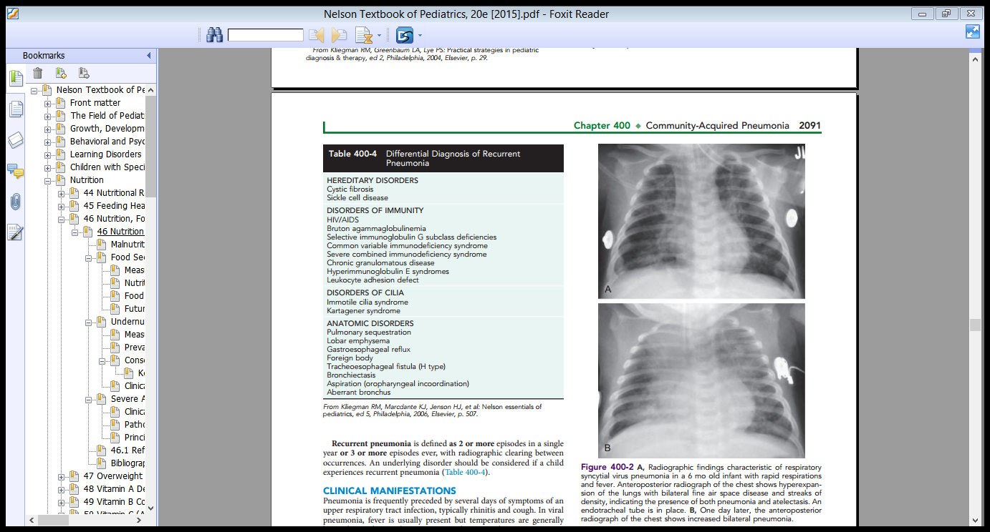
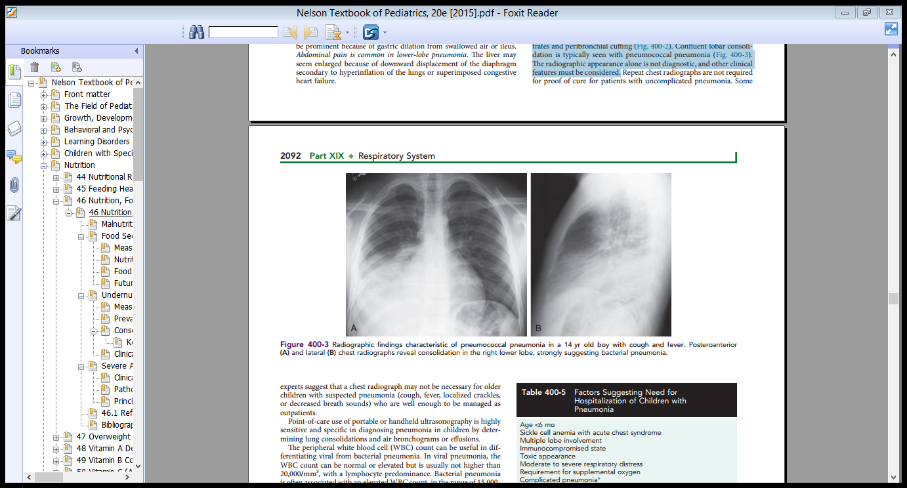

Slide 38
Isolation of organisms
Culture
The definitive diagnosis of a bacterial infection requires isolation of an organism from the blood, pleural fluid, or lung
Culture of sputum - little value in the diagnosis of pneumonia in young children
Blood cultures are positive in only 10% of children with pneumococcal pneumonia
Growth of respiratory viruses in tissue culture usually requires 5–10 days

Slide 39
Blood cultures are recommended for those who
  Fail to improve
  clinical deterioration
  With complicated pneumonia
  Requires hospitalization
Notes:
The definitive diagnosis of a bacterial infection requires isolation of
an organism from the blood, pleural fluid, or lung. Culture of sputum
is of little value in the diagnosis of pneumonia in young children, while
percutaneous lung aspiration is invasive and not routinely performed.
Blood culture results are positive in only 10% of children with pneu-mococcal pneumonia and are not recommended for nontoxic appear-ing children treated as an outpatient. Blood cultures are recommended
for those who fail to improve or have clinical deterioration, in those

Slide 40
PCR
Reliable DNA or RNA tests for the rapid detection of RSV, parainfluenza, influenza, and adenoviruses are available and accurate.
Serologic
Can also be used to diagnose a recent respiratory viral infection
Require testing of acute and convalescent serum samples for a rise in antibodies to a specific viral agent.
Notes:
The definitive diagnosis of a viral infection rests on the isolation of
a virus or detection of the viral genome or antigen in respiratory tract
secretions. Reliable DNA or RNA tests for the rapid detection of many
respiratory pathogens, such as mycoplasma, pertussis, and viruses,
including RSV, parainfluenza, influenza, and adenoviruses, are avail-able and accurate. Serologic techniques can also be used to diagnose a
recent respiratory viral infection but generally require testing of acute
and convalescent serum samples for a rise in antibodies to a specific
viral agent. This diagnostic technique is laborious, slow, and not gener-ally clinically useful because the infection usually resolves by the time
it is confirmed serologically. Serologic testing may be valuable as an
epidemiologic tool to define the incidence and prevalence of the
various respiratory viral pathogens. Patient peripheral cell gene expres-sion patterns determined by microarray reverse transcription poly-merase chain reaction is an emerging technology that may help
differentiate viral from bacterial causes of pneumonia

Slide 41
With the use of molecular diagnostic testing, a bacterial or viral cause of pneumonia can be identified in 40-80%
Notes:
This diagnostic technique is laborious, slow, and not generally clinically useful because the infection usually resolves by the time it is confirmed serologically.
Serologic testing may be valuable as an epidemiologic tool to define the incidence and prevalence of the various respiratory viral pathogens.

Slide 42
bacterial and viral pneumonia
D/C | Bacterial | Viral
presentation | HGF
WBC | 15,000-40,000/mm³ | normal or elevated but not higher than 20,000/mm³
differential | granulocyte | lymphocyte
CXR | A large pleural effusion, lobar consolidation
Notes:
It is often not possible to distinguish viral pneumonia clinically from disease caused by Mycoplasma and other bacterial pathogens.
It is often not possible to distinguish viral pneumonia clinically from disease caused by Mycoplasma and other bacterial pathogens.

Slide 43
Treatment
Treatment of suspected bacterial pneumonia is based on the presumptive cause and the clinical appearance of the child
A. Out patient management
For mildly ill children who do not require hospitalization
  Amoxicillin is recommended.
  In communities with a high percentage of penicillin-resistant pneumococci, high doses of amoxicillin (80–90 mg/kg/24 hr) should be prescribed.
  Therapeutic alternatives include cefuroxime axetil or amoxicillin/clavulanate.
Notes:
espite substantial gains over the past decade, in develop-ing countries only ≈60% of children with symptoms of pneumonia
(≈50% in sub-Saharan Africa) are taken to an appropriate caregiver,
and less than one-third receive antibiotics. The World Health Organi-zation and other international groups have developed systems to train
mothers and local healthcare providers in the recognition and treat-ment of pneumonia

Slide 44
For atypical pneumonias
  For school-aged children Macrolide such as azithromycin is an appropriate choice
  In adolescents, a respiratory fluoroquinolone (levofloxacin, gatifloxacin, moxifloxacin, gemifloxacin) may be considered
Notes:
For school-aged children and in those in whom infection with M. pneumoniae or C. pneumoniae (atypical pneumonias) is suggested
Macrolide antibiotic such as azithromycin is an appropriate choice.
In adolescents, a respiratory fluoroquinolone (levofloxacin, gatifloxacin, moxifloxacin, gemifloxacin) may be considered for atypical pneumonias.

Slide 45
Factors Suggesting Need for Hospitalization
Age <6 mo
Immunocompromised state
Toxic appearance
Moderate to severe respiratory distress
Hypoxemia (oxygen saturation <90% breathing room air, sea level)
Complicated pneumonia*
Sickle cell anemia with acute chest syndrome
Vomiting or inability to tolerate oral fluids or medications
Severe dehydration
No response to appropriate oral antibiotic therapy
Social factors (e.g., inability of caregivers to administer medications at home or follow-up appropriately)
* Pleural effusion, empyema, abscess, bronchopleural fistula, necrotizing pneumonia
acute respiratory distress syndrome, extrapulmonary infection (meningitis, arthritis, pericarditis,
osteomyelitis, endocarditis), hemolytic uremic syndrome, or sepsis

Slide 46
B. Hospitalized patients
The empirical treatment of suspected bacterial pneumonia requires an approach based on the clinical manifestations at the time of presentation

Slide 47
Ampicillin or penicillin G indicated
  In areas without substantial high-level penicillin resistance among S. pneumoniae
  Children who are fully immunized against H. influenzae type b and S. pneumoniae
  Children who are not severely ill
For children who do not meet these criteria, ceftriaxone or cefotaxime should be used.

Slide 48
  If clinical features suggest staphylococcal pneumonia (pneumatoceles, empyema), initial antimicrobial therapy should also include vancomycin or clindamycin.

Slide 49
Up to 30% of patients with known viral infection may have coexisting bacterial pathogens
deterioration in clinical status should signal the possibility of superimposed bacterial infection and antibiotic therapy should be initiated
Notes:
Therefore, if the decision is made to withhold antibiotic therapy based on presumptive diagnosis of a viral infection, deterioration in clinical status should signal the possibility of superimposed bacterial infection and antibiotic therapy should be initiated

Slide 50
Duration of treatment
continued until the patient has been afebrile for 72 hr
The total duration should not be less than 10 days (or 5 days if azithromycin is used)
Shorter courses (5-7 days) may also be effective, particularly for children managed on an outpatient basis, but further study is needed
Notes:
The optimal duration of antibiotic treatment for pneumonia has not been
well-established in controlled studies. However, antibiotics should gen-erally be continued until the patient has been afebrile for 72 hr, and
the total duration should not be less than 10 days (or 5 days if azithro-mycin is used). Shorter courses (5-7 days) may also be effective, par-ticularly for children managed on an outpatient basis, but further study
is needed. Available data do not support prolonged courses of treat-ment for uncomplicated pneumonia. In developing countries, oral zinc
(10 mg/day for <12 mo, 20 mg/day for ≥12 mo) reduces mortality
among children with clinically defined severe pneumonia

Slide 51
Oral zinc may reduces mortality in severe pneumonia - developing countries
supportive care and may require intravenous fluid
respiratory support ( INO2,CPAP , MV)
Bubble CPAP improves mortality compared with standard oxygen therapy in settings without access to ventilator derived CPAP or mechanical ventilation
vasoactive medications for hypotension or sepsis physiology

Slide 52
Response To Treatment
uncomplicated community-acquired bacterial pneumonia respond to therapy with improvement in
  Clinical symptoms (fever, cough, tachypnea, chest pain) within 48–96 hr of initiation of antibiotics
  Cough 6-10days
  Radiographic evidence of improvement substantially lags behind clinical improvement

Slide 53
A number of possibilities must be considered when a patient does not improve with appropriate antibiotic therapy
  A repeat chest x-ray is the 1st step in determining the reason for delay in response to treatment
Broncho alveolar lavage - in children with respiratory failure
High resolution CT scans -identify c omplications or an anatomic reason for a poor response

Slide 54
DDX
    1 complications
    2 bacterial resistance
    3 nonbacterial etiologies such as viruses and aspiration of FB or food
    4 bronchial obstruction from endobronchial lesions, foreign body, or mucous plugs;
    5 pre-existing diseases
    6 other noninfectious causes (including bronchiolitis obliterans, hypersensitivity pneumonitis, eosinophilic pneumonia, aspiration, and Wegener granulomatosis)

Slide 55
Complications
usually the result of
  Direct spread of bacterial infection within the thoracic cavity
    Pleural effusion
    Empyema
    Pericarditis
  Bacteremia and hematologic spread
    Meningitis
    Suppurative arthritis
    Osteomyelitis
Notes:
Are rare complications of hematologic spread of pneumococcal or H. influenzae type b infection

Slide 56
Empyema
S. aureus, S. pneumoniae, and S. pyogenes are the most common causes of parapneumonic effusions and of empyema
ultrasonography and CT
  helpful in determining the stage of empyema

Slide 57
The treatment of empyema is based on the stage
  Exudative
  Fibrinopurulent
  Organizing

Slide 58
The mainstays of therapy
  antibiotic therapy
  drainage with tube thoracostomy with instillation of fibrinolytic therapy (urokinase, streptokinase, alteplase)
  Selected video-assisted thoracoscopy (VATS) to debride, lyse adhesions, and drain loculated areas of pus
  Early diagnosis and intervention, particularly with VATS, may obviate the need for thoracotomy and open debridement.
Notes:
Small (<1 cm on lateral decubitus radiograph), free-flowing parapneumonic
effusions often do not require drainage but respond to appropriate antibiotic
therapy. Larger effusions should typically be drained, particularly if the effusion
is purulent (empyema) or associated with respiratory distress

Slide 60
Prognosis
Mortality from community-acquired pneumonia in developed nations is rare
Most children with pneumonia do not experience long-term pulmonary sequelae
Notes:
Some data suggest that up to 45% of children have symptoms of asthma 5 yr after hospitalization for pneu-moni
this finding may reflect either undiagnosed asthma at the time of presentation or a propensity for development of asthma after
pneumonia.

Slide 61
Prevention
Vaccination against
  Pneumococcal (PCV—13)in US
  Influenza vaccine recommendations to include all children >6 mo of age
Notes:
Some evidence exists to suggest that vaccination has reduced the incidence of pneumonia hospitalizations.
The annual rate of all-cause pneumonia hospitalization among children younger than 2 yr of age
in the United States during the period 1997-1999 was 12.5 per 1,000
children. In February 2000, the 7-valent pneumococcal conjugate
vaccine (PCV7) was licensed and recommended. In 2006, the pneu-monia hospitalization rate in this age group was 8.1 per 1,000 children,
a 35% decrease from the prevaccine rate. Although these data do not
establish that PCV7 directly reduced pneumonia hospitalization rates,

Slide 62
Read on
Bronchiolitis
Pleurisy ,pleural effusion and empyema
Bronchiectasis
Pulmonary abscess

Slide 63
Thank you

